Slide 1

Python as an Additional Language
Lesson 3: Stealing from others, going loopy

Slide 2
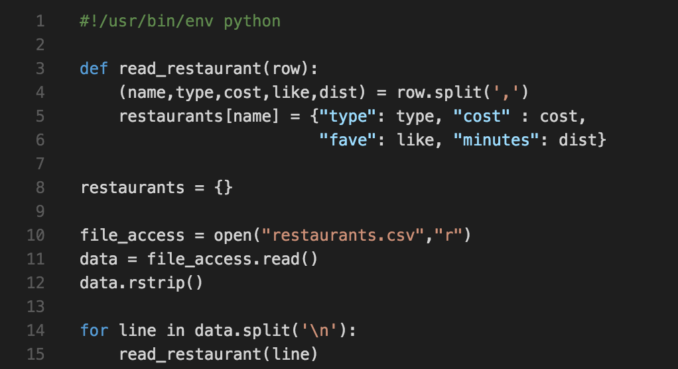

Where did we get to?

Slide 3
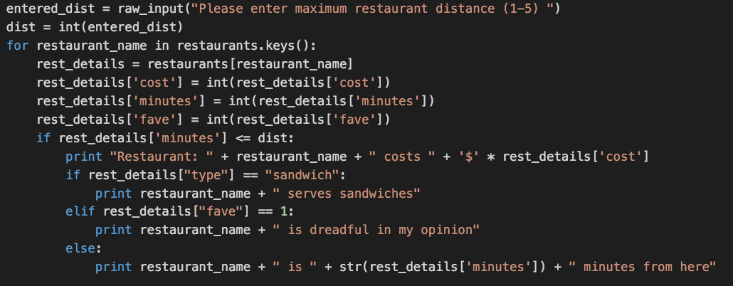
Here’s my solution to last week’s exercise

Slide 4

Revisiting files
How does this differ from how we did this before?
Notes:
When inside a with codeblock, the target’s __enter__() method is called. At the end of the block __exit__() is called. In this case __exit__() contains a close() call.

Slide 5
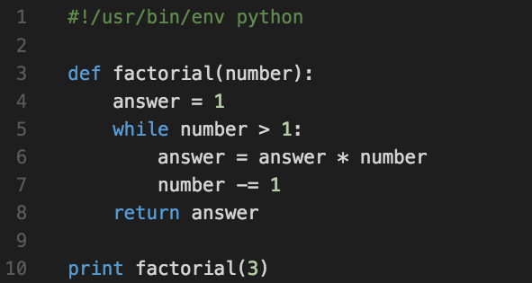
Revisiting functions – a diversion
What happens if we miss out the return statement?

Slide 6
Revisiting functions – a diversion
Exercise: Rewrite the previous slide to perform the same job, without the while loop

Slide 7
New data types: Lists and other iterables
What is the data type returned by restaurants.keys() ?
What properties does it have?
There are other data types with similar properties – you’ve already met some of them!

Slide 8
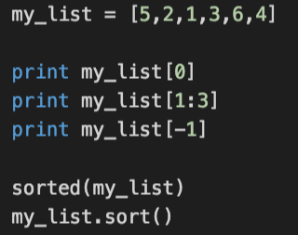
Ordering lists around
Lists are a fixed order – but that order can be changed
What will these statements do (don’t type them in yet)?

Slide 9
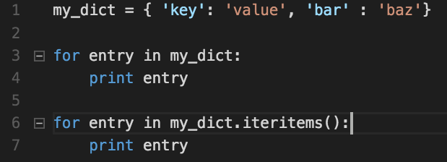
What about dictionaries?

Slide 10

… and other data types?
Try iterating over a string
There’s one other iterable data type you might find useful – a set:
Many (but not all) iterables can be cast to a set – try:
Strings
Dictionaries (both directly and using iteritems() )

Slide 11
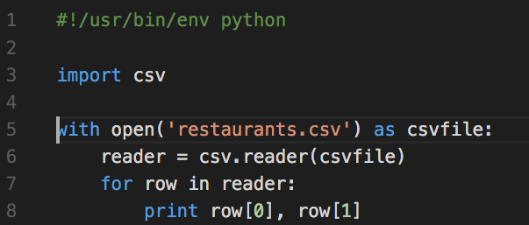
How to steal from others
Python has an enormous standard library. Let’s make use of it.
What is the datatype of reader? Of row?

Slide 12
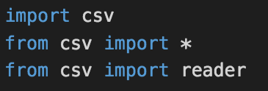
Different ways of importing
What is the difference between each of these?
When we want more information on a python file we can use pydoc

Slide 13
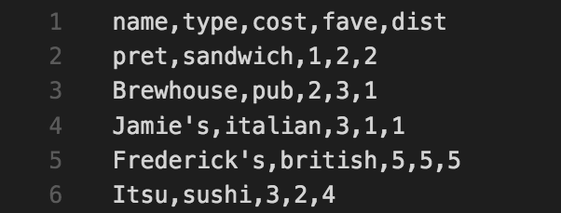
Making use of column titles

Slide 14
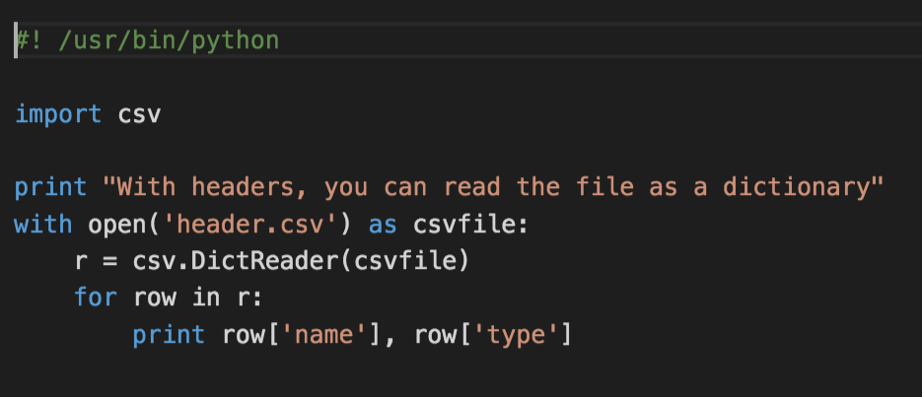
Back to the dictionary

Slide 15
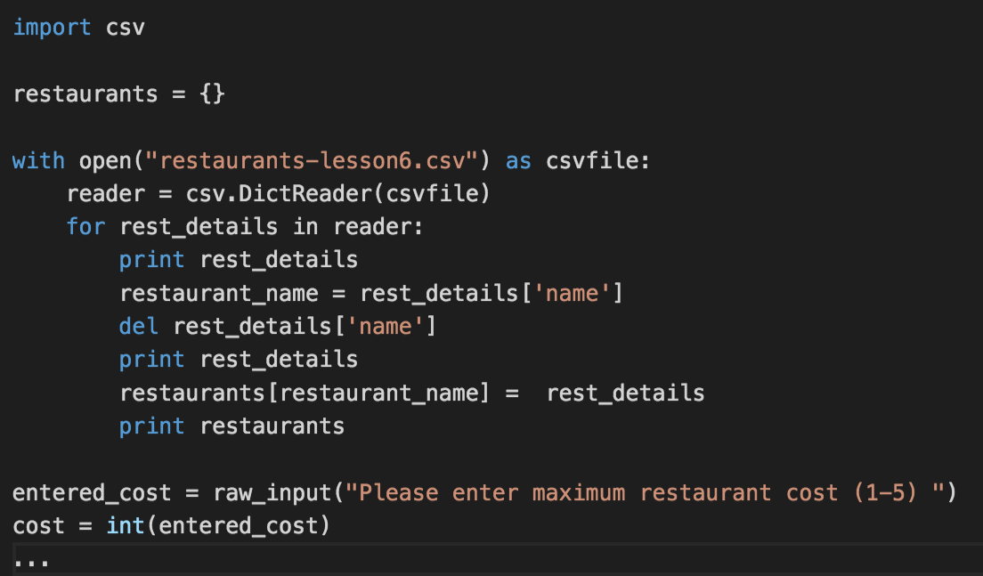
What does this do?

Slide 16
Let’s expand on that…
Make your program print out the restaurants that are no more than X minutes away – prompt the user for the value of X
Can you think of a way to combine the score fields in an “interesting” fashion? (Generate a score for each place based on its attributes and print them out in that order)
Drop-in Session: Monday, S26, 11-12

